Slide 1
SANITATION AND HYGIENE UPDATES FOR BULAMBULI DISTRICT.
Presented by
Vincent Natega, SEHO/Ag.ADHO-EH
October 1st 2019, at Bulambuli District CAO’s Board Room.

Slide 2
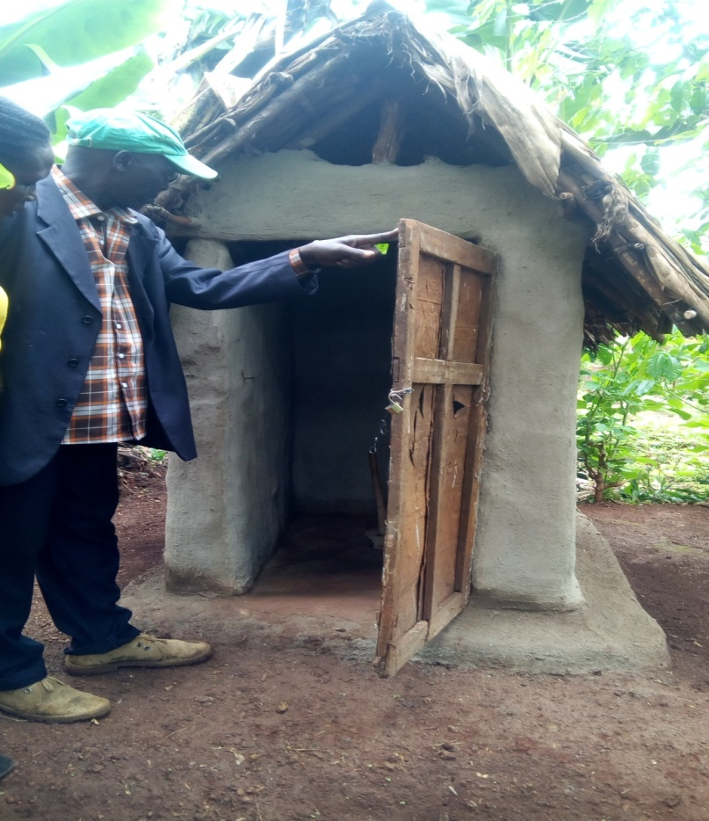
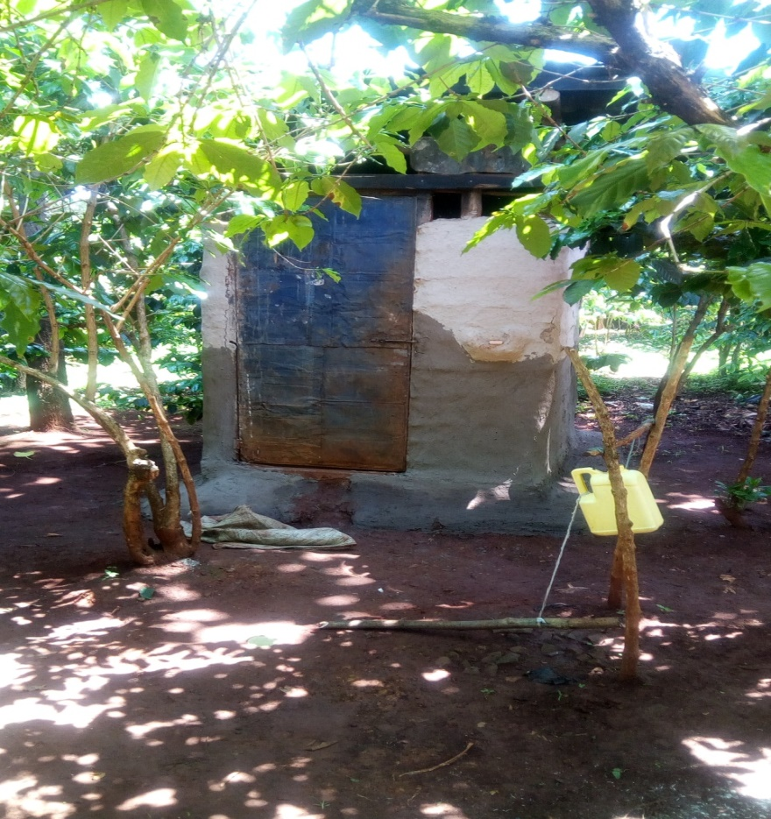
MOH, Environmental Health Department Target 6.2:
By 2030, achieve access to adequate and equitable sanitation, hygiene for all and end open defecation, paying special attention to the needs of women and girls and those in vulnerable situations

Slide 3
DISTRICT PROFILE
Bulambuli District has two geographical locations of Elogon county which covers 75% (mountainous), prone to landslides and Bulambuli county 25%(lower),prone to floods leading to out breaks like cholera, high malaria prevalence etc.
The District has the following Administrative units;
02Counties
23 Sub counties
03 Town councils

Slide 4
cont’d
1299 Villages with 2598 VHTs, 111 parishes and 46690 households
Projected population of 209000 and land area of 809.65sq kilometers
25 Health Facilities,1 health Centre IV, 14 Health Centre III and 10 Health Centre II
23 Public, 2 PNFP Health Centre II is among the 10 Health Centre II above.

Slide 5
Progress on USF/ Sanitation and Hygiene targets
246/418 villages triggered have been declared for ODF, although the District is having 1299 villages.
Latrine coverage is at 39313/46690 giving 84.2% from 57% as per 2015.
Hand washing is at 18023/46690 giving 38.6% from 0.7% as per 2015.

Slide 6
The ODF Performance graph

Slide 7
Results out come
Bulegeni Town Council, Bumasobo Sub county and part of Namisuni sub county have attracted many visitors from different Districts in together with MOH for learning purposes.
Bulambuli District has been selected among 134 to host national sanitation week commemoration which always takes place in the third week of march every calendar year with aim motivating Bulambuli to work towards ODF attainment through behaviour change, demand creation and enabling.

Slide 8
Strategies for ODF Villages/cells attainment in Bulambuli District.
Formation of sanitation and hygiene committees at Villages/cells, parishes, sub county and District, each committee should have nine(9) members.
Scale up of advocacy and community dialogue meetings to Parishes, Sub county and District with stake holders ie Political, Technical, women groups, youth, Religious, cultural and elderly etc.
Displaying names of latrine defaulters in trading Centres and shaming them.
Setting competitions for sub counties/town councils.
Giving nuisance notices to latrine defaulters by the VHTs, parish chiefs/town agents, Health Assistants, Health Inspectors and Community Development Officers under the super vision of Senior Assistant Secretary/Town Clerks, failure to compile will lead the arrest of the defaulters.

Slide 9
Cont’d
Functionalizing sub county court to handle latrine defaulters, after sub county failing defaulters are to be handed over to police.
Increased publicity over radios on sanitation and hygiene by RDC and Chairperson LCV together with other stake holders.
Monitoring and support super vision of the sub county team by CAO’s Office and DHO’s office on hygiene and sanitation latrine and hand washing defaulters.
Regular meetings and updates on sanitation and hygiene at all administrative units.
Institutional triggering and follow up MANDONA.

Slide 10
Suggested Action plan for Bulambuli District hosting national sanitation week.
S/N | Activity | Indicators | Source of funding | Time frame | Responsible officer
01 | Preparatory and feed back on sanitation activities meetings | Attendance Minutes and Reports | District | weekly | CAO
02 | Community dialogue meetings at parish level | Attendance Minutes and Reports | Uganda sanitation fund | Daily starting on 2nd Wednesday 2019 | ADHO-EH
03 | Formation of sanitation and hygiene committees at every administrative unit | Attendance Minutes and Reports | No funding | 1st week of October | CAO

Slide 11
Suggested Action plan for Bulambuli District hosting national sanitation week.
S/N | Activity | Indicators | Source of funding | Time frame | Responsible officer
04 | Inspection of water sources and water quality surveillance testing | Reports | DSHG | weekly | DWO
05 | Inspection of intuitions Ie schools, health centers, Offices, and police station | Reports | Uganda sanitation fund | 6th Jan-17th/03/2020 | ADHO-EH
06 | Inspection of public places and super vision ie Markets, trading centers | Reports | PHC | 02nd/11/2019-19th/03/2020 | DHO

Slide 12
Suggested Action plan for Bulambuli District hosting national sanitation week.
S/N | Activity | Indicators | Source of funding | Time frame | Responsible officer
07 | Open defecation free(ODF) Environment Assessment | Reports | Uganda sanitation fund (USF) | 3rd /10/2019-13/03/2020 | ADHO-EH
08 | Meeting with District Partners | Attendance Minutes and Reports | District | 7th October, 2019 -17th/03/2020 | CAO and DHO
09 | Consultation with MOH to identify Chief guest and logistic | Reports | No funding | 02nd/11/2019-19th/03/2020 | LCV and CAO

Slide 13
Suggested Action plan for Bulambuli District hosting national sanitation week.
S/N | Activity | Indicators | Source of funding | Time frame | Responsible officer
10 | Identifying the suitable venue | Reports | No funding | 1st October 2019 | DTPC-Meeting
11 | National week sanitation commemoration | Attendance Minutes and Reports | District | 20th/03/2020 | CAO

Slide 14


